Slide 1
Combined Leverage

Slide 2
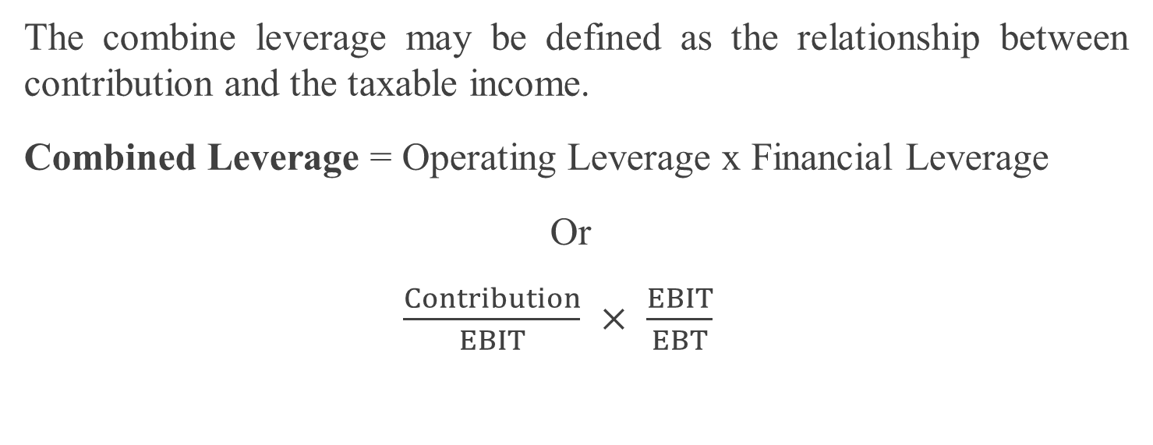
Meaning of Combined Leverage
The combine leverage may be defined as the relationship between contribution and the taxable income.
Combined Leverage = Operating Leverage x Financial Leverage
Or
$\frac{Contribution}{EBIT}$$×$$\frac{EBIT}{EBT}$

Slide 3
Degree of Combined Leverage
DCL measures the percentage change in earnings per share due to percentage change in sales.DCL= DOL × DFL
Or
$\frac{\% Change in EBIT}{\% Change in Sales}$$× \frac{\% Change in EPS}{\% Change in EBIT}$
Or
$\frac{\% Change in EPS}{\% Change in Sales}$

